Slide 1
RL: Discretization of belief space for partially observable Markov decision process.
Yoon, Hyung-Jin, Donghwan Lee, and Naira Hovakimyan. "Hidden Markov model estimation-based q-learning for partially observable Markov decision process." 2019 American Control Conference (ACC). IEEE, 2019.
Notes:
The hidden state estimation in the previous work is extended to reinforcement learning.

Slide 2
RL - POMDP (Partially Observable Markov Decision Process)
An Example
Exploration: Get observations and tests.
Exploitation: Treatment based on current belief.
Pineau, Joelle. "A POMDP Tutorial." European Workshop on Reinforcement Learning.(review on recent research). 2013.
Notes:
POMDP (Partially Observable Markov Decision Process) is a model of environment for reinforcement learning. In contrast to MDP (Markov Decision Process), the POMDP incorporate incomplete state observation.
In this illustrative example of POMDP shows the decision making procedure with incomplete state observation. Here, the doctor (or agent) first observes the patient. However, the doctor only sees symptoms, but the type of disease which cause the symptom cannot be known by the single observation. So the doctor needs more observations to update prior guess on the type of disease. When the doctor is certain on the type of the disease the doctor can decide to use more critical treatment. This decision making in the example looks natural to us because we also use the sequence of observation to estimate the hidden state.
However, in contrast to POMDP, if we use MDP assumption in the example, the doctor observes the full state information as if knowing the type of disease immediately then the doctor can just try matching right treatment for the known disease of the patient.
So the POMDP is a more suitable model than MDP for the human-robot interaction application.

Slide 3
RL - HMM based reinforcement learning with POMDP
We integrate Hidden Markov model (HMM) estimation and reinforcement learning under incomplete state observation.
We proved the convergence of the action value function (Q-function) on discretized belief space using stochastic approximation techniques.
Notes:
We integrate a Hidden Markov Model estimator with reinforcement learning with POMDP. It is easy to see that if we excite the output feedback system (the POMDP) with a fixed control law (the behavior policy), then the controlled system is a Hidden Markov Model.
Using online HMM estimator, we can use state estimator to estimate the optimal value function and also the model parameters of the POMDP. In other words, this is an online output feedback system identification while estimating the optimal value function.
In the language of reinforcement learning, this is an online algorithm for model-based RL with incomplete state observation.
We used the stochastic approximation to prove the convergence of the algorithm. The stochastic approximation is used to design and analyze a sample based online estimation problem. Examples include reinforcement learning, stochastic gradient descent for deep learning, and online communication resource allocation policies in communication network optimization.

Slide 4
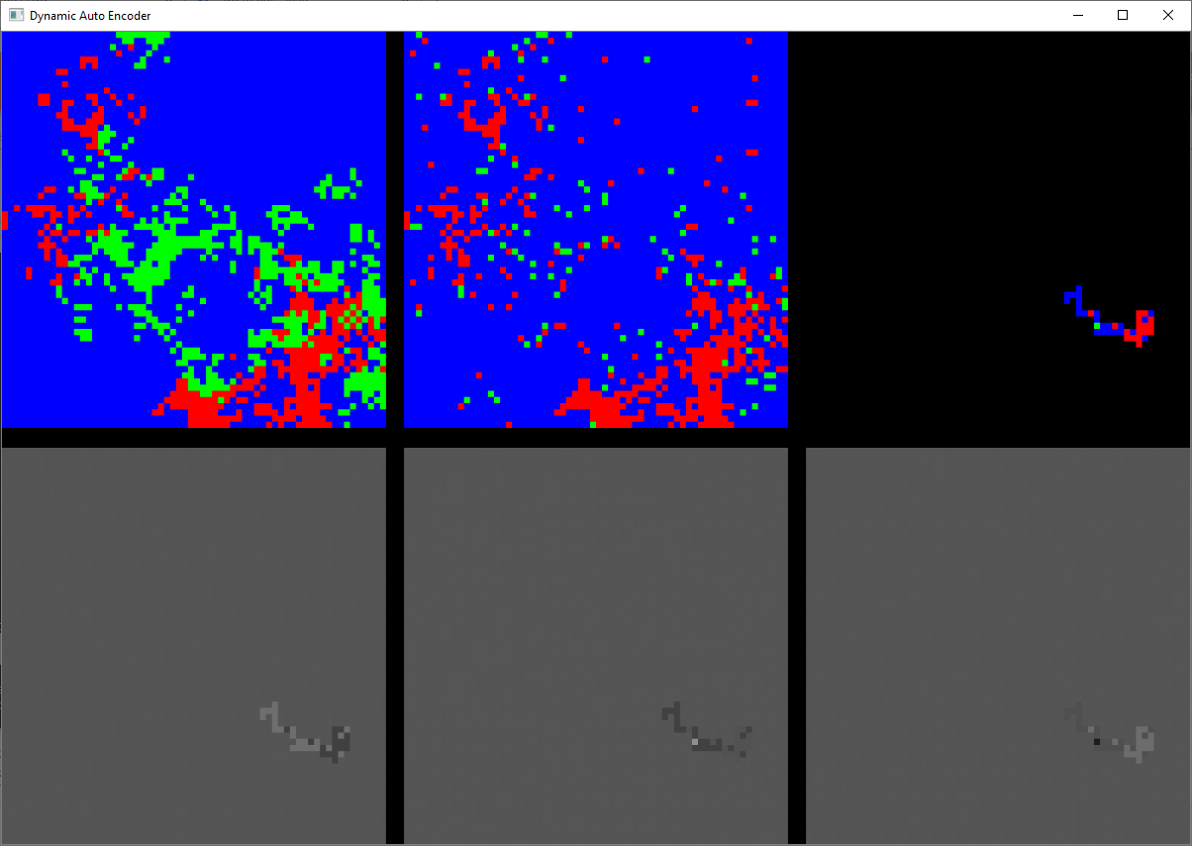
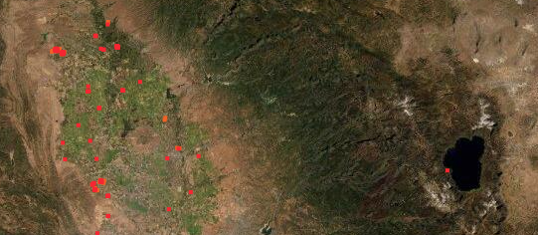
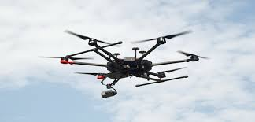
RL – Application: Exploration in Unknown Environment
Estimation/Planning Task:
Multi-level stochastic optimization:
Given the path dependent observation
Reinforcement Learning (belief state MDP*)
High-level
(fast varying)
Observation
state estimate
State Estimation
(spatiotemporal model)
Middle-level
(slowly varying)
state estimate
map observation
recursively estimate state/model and plan next short-term path to visit fire grids.
cost parameters
(action)
Short Term Path Planning (dynamic constraint)
Low-level
(time invariant)
State Grid Map
target trajectories
map observation, UAVs state
Environment
*MDP stands for Markov decision process.
Notes:
We consider the following task where the vehicle can observe around the path and the vehicle aims to visit the red colored grid. Because the model is not available, we have two learning components. The reinforcement learning

Slide 5
Model Predictive Path Integral (MPPI):
Monte-Carlo simulation-based Path integral method for approximate solution of finite time horizon optimal control in MPC.
Complexity : Sampling complexity for the simulation-based optimization for the stochastic control tasks.
Yoon, Hyung-Jin, Chuyuan Tao, Hunmin Kim, Naira Hovakimyan, and Petros Voulgaris. "Sampling complexity of path integral methods for trajectory optimization." In 2022 American Control Conference (ACC), pp. 3482-3487. IEEE, 2022.
Tao, Chuyuan, Hyung-Jin Yoon, Hunmin Kim, Naira Hovakimyan, and Petros Voulgaris. "Path integral methods with stochastic control barrier functions." In 2022 IEEE 61st Conference on Decision and Control (CDC), pp. 1654-1659. IEEE, 2022.
Notes:
The hidden state estimation in the previous work is extended to reinforcement learning.

Slide 6
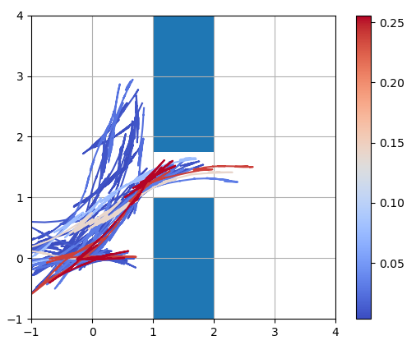
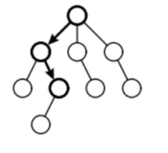


MPPI - Background
Decision Making using Simulation
Sampling of Trajectories
high
performance
low
While making important decisions, it is common to simulate potential future consequences with arbitrary decisions before taking any actions.
An approach is to aggregate multiple sample trajectories according to the performance.
Notes:
The sampling-based methods are similar to a way of decision-making in our life. (read) While … In the stochastic approximation of the optimal control, a large number of samples are queried in parallel, typically with GPU. This approach aggregates multiple sample trajectories according to performance. The outcome of the stochastic approximation is the soft-max performance trajectory.

Slide 7
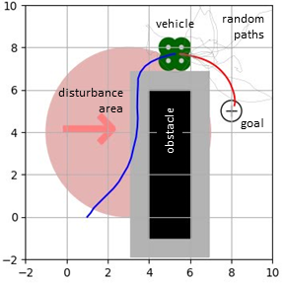
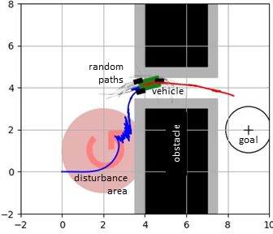
MPPI - Path integral method
Using GPU, a large number of sample trajectories can be generated in real time.
Aggregated trajectory
10,000 trajectories with 50 time steps
Aggregated trajectory
Notes:
(read) Using GPU, a large …

Slide 8
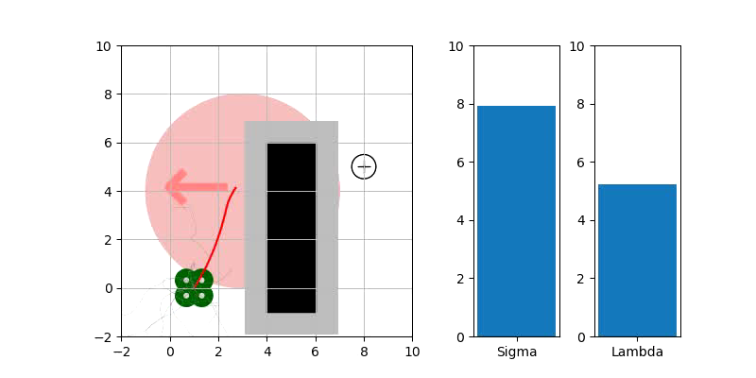
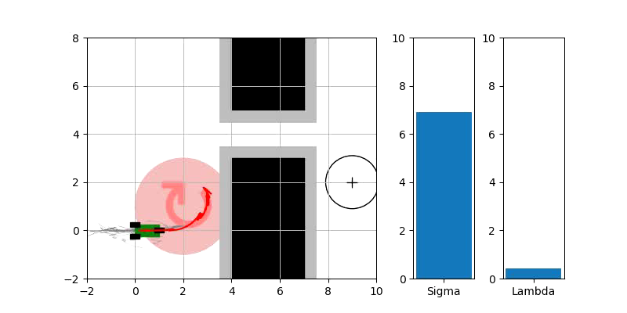
MPPI - Path integral method
Real time calculation of the optimal trajectories is useful in autonomy pipeline.
Notes:
The real time calculation of the optimal trajectories is useful in autonomy pipeline.

Slide 9
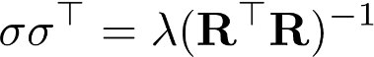
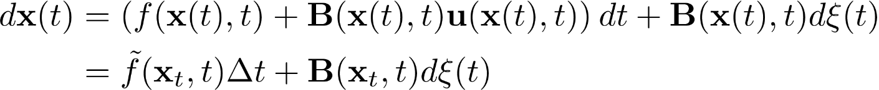
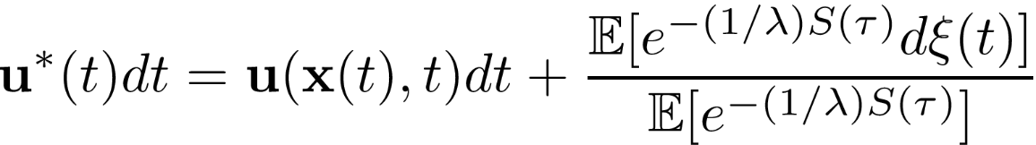
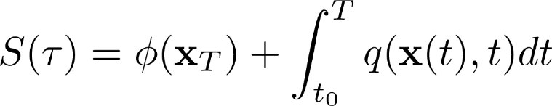
MPPI - Path integral method*
Consider the finite horizon optimal control with the following stochastic dynamic and cost.
random perturbation (Brownian motion)
Path Integral Method [Kappen 2005] calculates the optimal control using samples from uncontrolled with the constraint where $σ$ is the covariance of the random perturbation
random perturbation
where
Path integral cost
Cost weighted random perturbation
*Kappen, Hilbert J. "Path integrals and symmetry breaking for optimal control theory." Journal of statistical mechanics: theory and experiment 2005.11 (2005): P11011.
Notes:
(click next click next) The path integral method is a stochastic approximation of optimal control. First, it samples random trajectories using the dynamics of the vehicle with random perturbation input. For each trajectory, the cost is calculated.
(click next)Finally, the random perturbation is weighed according to the cost value as shown in this expectation.

Slide 10
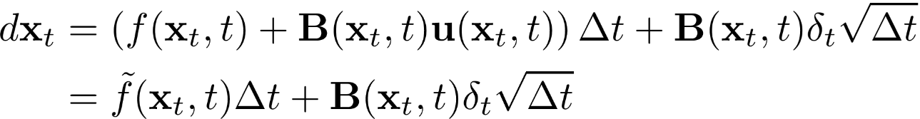
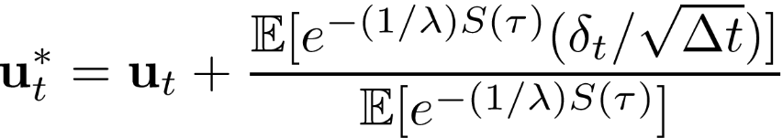
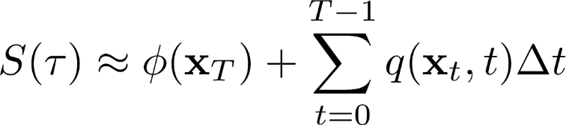
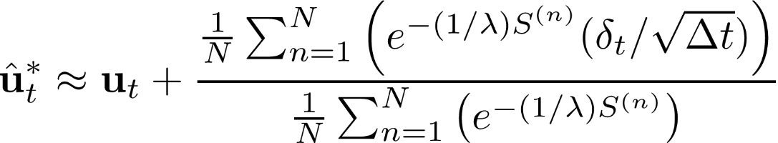
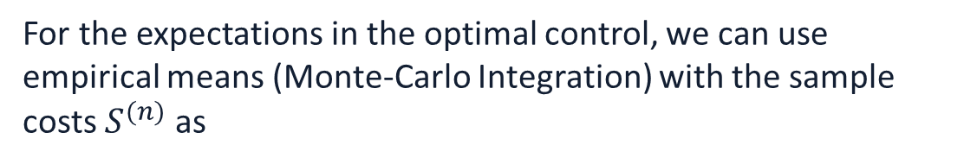
MPPI - Monte-Carlo integration of the optimal control*
The continuous-time trajectories are sampled using a discrete time system with Gaussian noise
random perturbation (Brownian motion)
with the discrete time optimal control
where
For the expectations in the optimal control, we can use empirical means (Monte-Carlo Integration) with the sample costs $S^{(n)}$ as
How many sample trajectories are required for the Monte-Carlo Integration given
Predefined uncertainties
Dynamics and cost function
*Kappen, Hilbert J. "Path integrals and symmetry breaking for optimal control theory." Journal of statistical mechanics: theory and experiment 2005.11 (2005): P11011.
Notes:
The expectation in the previous slides can be estimated using MonteCarlo integration. Now, a question is
(read) How many sample …

Slide 11
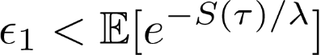
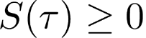
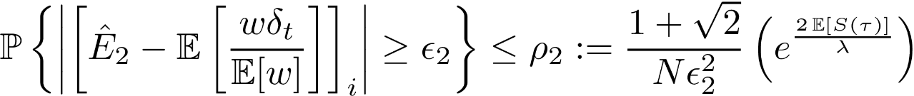
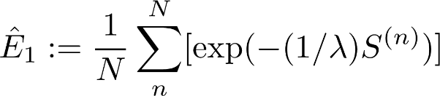
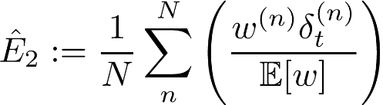
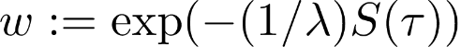
MPPI - Sampling complexity of the MC integration
Assumption 1.
Assumption 2. Nonnegative terminal and running cost, i.e.,
Proposition 1. Under Assumptions 1 and 2, the multiplicative (in terms of $ε_{1}$) and additive error (in terms of $ε_{2}$) between the optimal control $u_{t}^{∗}$ and the MC integration ${\hat{u}}_{t}^{∗}$are as follows:
The error bounds $ε_{1}$ and $ε_{2}$ are from the following MC integration bounds for the number of sample trajectories $N$ that determine the risks $ρ_{1}$ and $ρ_{2}$ as
We can use the bound to evaluate
the uncertainties of MC, given sample trajectories cost
how challenging the MC is, given dynamics and cost, when you can calculate the path integral cost
where
,
, and
.
Notes:
To answer the question, I have calculated a bound on the variance of the random variable in MonteCarlo integration.
(read) We can use the bound to evaluate ….

Slide 12
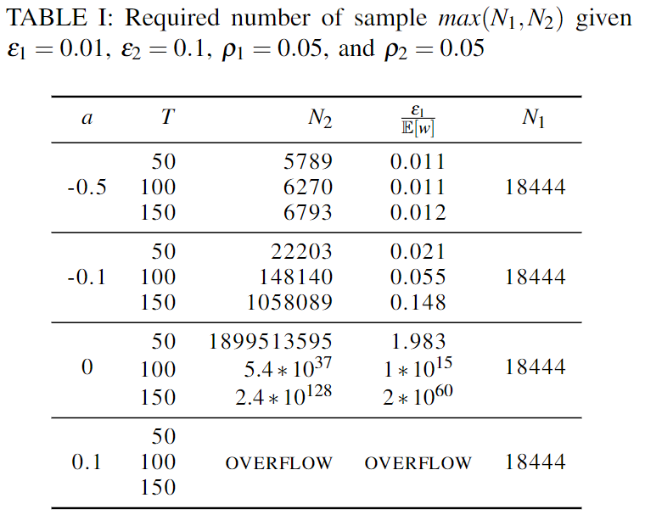
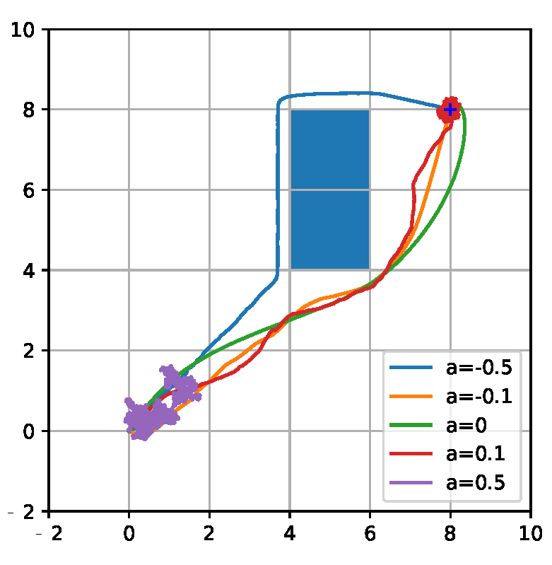
MPPI - Sampling complexity given stability of linear system
For the Double integrator system, we can calculate the expectation of the cost and apply Proposition 1.
Stable systems tends to have shorter flight path that is an optimal behavior.
Notes:
To see how the sampling complexity is applied to a linear system with varying stability. As shown in the table, the required number of samples, N2, increases as the system becomes unstable. The trajectory follows the shorted distance path on the right-hand side figure with the most stable system. However, the vehicle could not reach the target with the unstable system.

Slide 13
Adversarial Machine Learning for Autonomous Vehicle:
Min-max optimization framework to robustify perception-based control that utilizes high-dimensional sensors, e.g., camera, lidar, and radar.
Yoon, Hyung-Jin, Hamidreza Jafarnejadsani, and Petros Voulgaris. "Learning When to Use Adaptive Adversarial Image Perturbations against Autonomous Vehicles." in IEEE Robotics and Automation Letters, doi: 10.1109/LRA.2023.3280813
Notes:
The hidden state estimation in the previous work is extended to reinforcement learning.

Slide 14
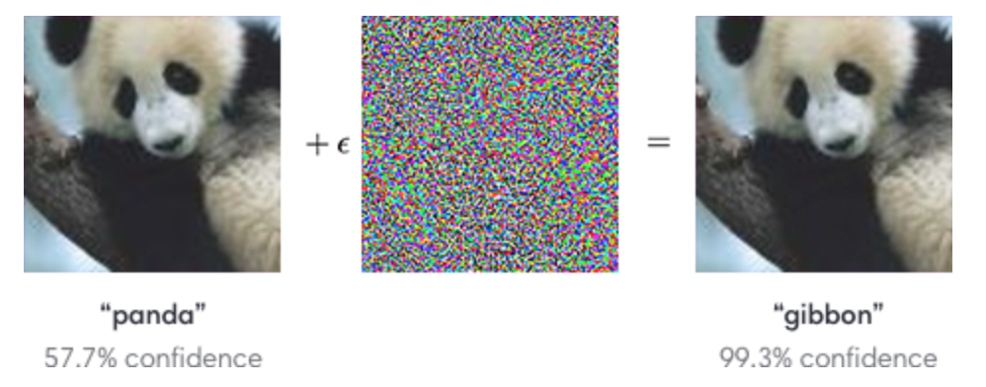
Adv.ML - Background
Adversarial Machine Learning (Adv.ML)
Adv. ML aims to find weakness of ML tool so that the ML tool can be robustified.
The deep learning classifier shows vulnerability to mere noise. The deep learning model can have a weak point in terms of performance, depending on the class of the object.
Kurakin, Alexey, Ian Goodfellow, and Samy Bengio. "Adversarial machine learning at scale.“ arXiv preprint arXiv:1611.01236 (2016).
Notes:
In this example, the deep learning classifier makes errors due to the additive noise. Therefore, adversarial machine learning aims to find a weakness of machine learning tools so that the machine learning tool can be robustified.

Slide 15
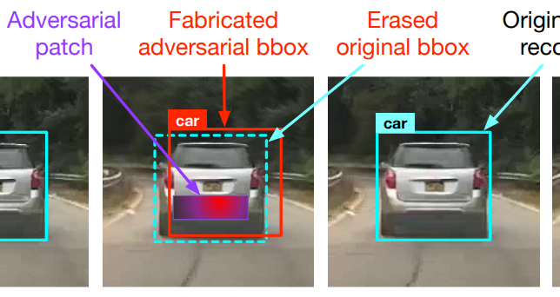
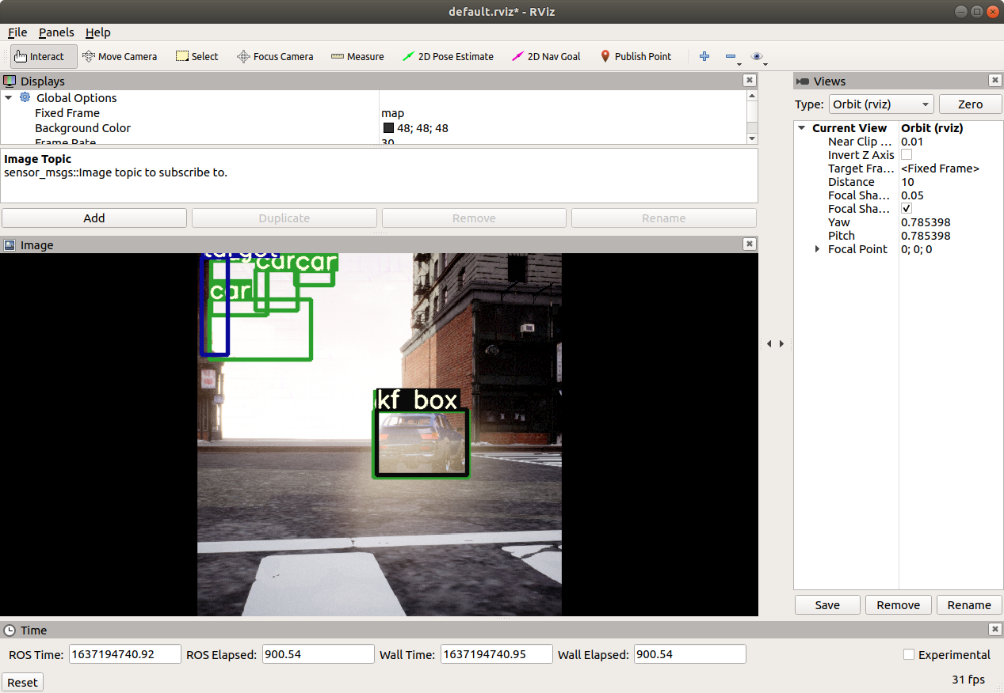
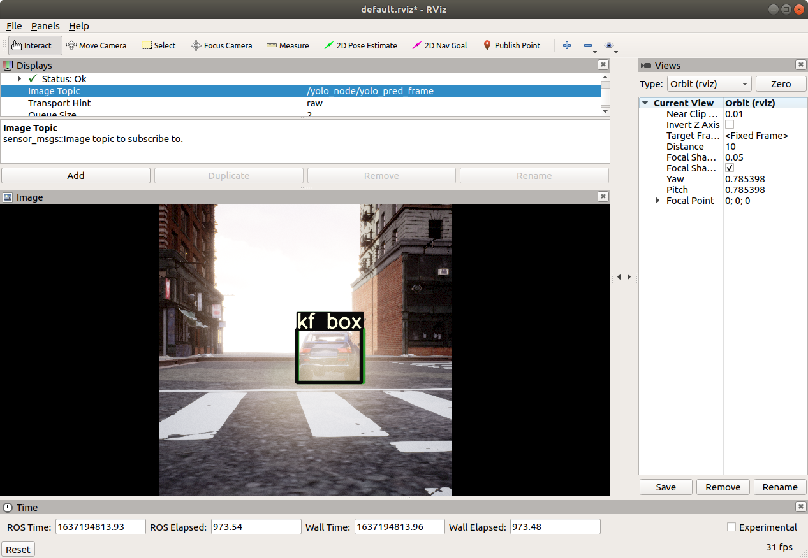
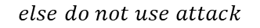
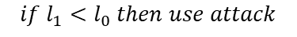
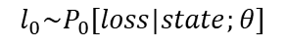
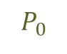
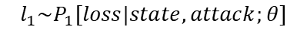
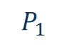
Adv.ML - Proposed framework
We propose a stochastic optimization framework that monitors the attacker's capability of generating the adversarial perturbations.
Adversarial Patch
Fabricated BBox
Erased Original
BBox
Stochastic Binary Decision
target
$$l_{1}\sim P_{1}[loss|state, attack;θ]$$
$$l_{0}\sim P_{0}[loss|state;θ]$$
$${if l}_{1}<l_{0} then use attack$$
$$else do not use attack$$
$$P_{1}$$
$$P_{0}$$
proficient
incapable
Use image attack
←
image attack loss
→
Do not use image attack
Existing Method*
Proposed Adaptive Method
*Jia, Yunhan, et al. "Fooling Detection Alone is Not Enough: First Adversarial Attack against Multiple Object Tracking." International Conference on Learning Representations (ICLR). 2020.
Notes:
(read) We propose …
Compared to the existing method, the proposed method has stealthier than the existing work. As shown in the image on the left, the adversarial patch is very colorful and bright. Furthermore, the existing work generate the adversarial patch off-line but our method generate the signal real-time.

Slide 16
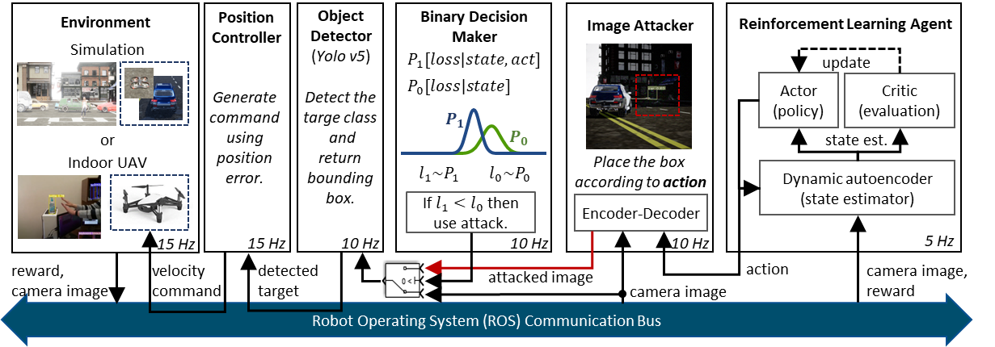
Adv.ML - Implementation of the framework
The proposed framework is implemented using ROS for online communication and simultaneous running of the following modules.
Notes:
The proposed framework is implemented using ROS for online communication and simultaneous running of the following modules.

